Slide 1
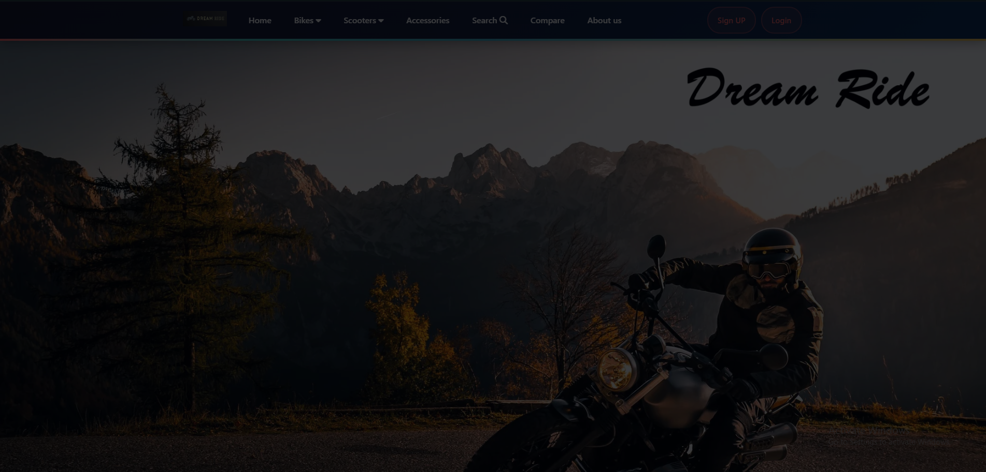

BIKE STORE MANAGEMENT SYSTEM
Course Name: Junior Design
Course Code: CSE299
Section: 04
Group: 04
Git Repository: https://github.com/Nasim227/CSE299_Group-4.git
Group Members
Md. Nasim Ahmed ID: 2232936042
Md. Abir Hasan ID: 2021833642
Md Murad Ul Momin ID: 2232360642

Slide 2




INTRODUCTION
Manual processes in bike stores cause errors, delays, and inefficiency.
Need for a digital solution to manage sales, stock, and customer interactions.
Goal: Provide speed, accuracy, and better user experience for both customers and managers.
Developed a web-based Bike Store Management System.
Group :04
Md. Nasim Ahmed ID: 2232936042
Md. Abir Hasan ID: 2021833642
Md Murad Ul Momin ID: 2232360642

Slide 3




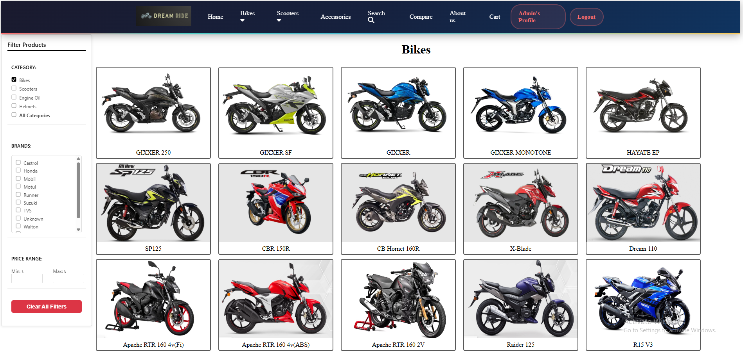
WHY DIFFERENT & NEEDED
Large platforms are
complex and costly for
small retailers.
Our system fills these
gaps with
specialized, user-
friendly design.
Small e-commerce sites lack
advanced features
It combines browsing,
booking, tracking, and
invoicing.
Group :04
Md. Nasim Ahmed ID: 2232936042
Md. Abir Hasan ID: 2021833642
Md Murad Ul Momin ID: 2232360642

Slide 4

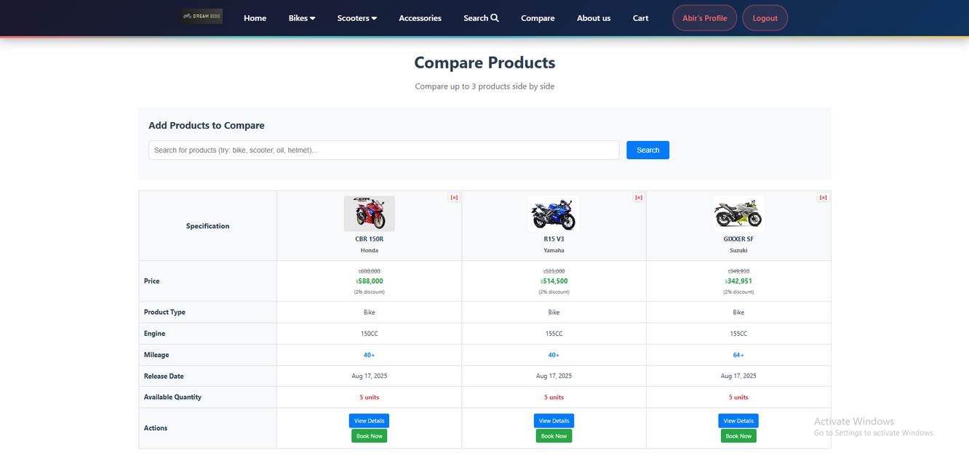
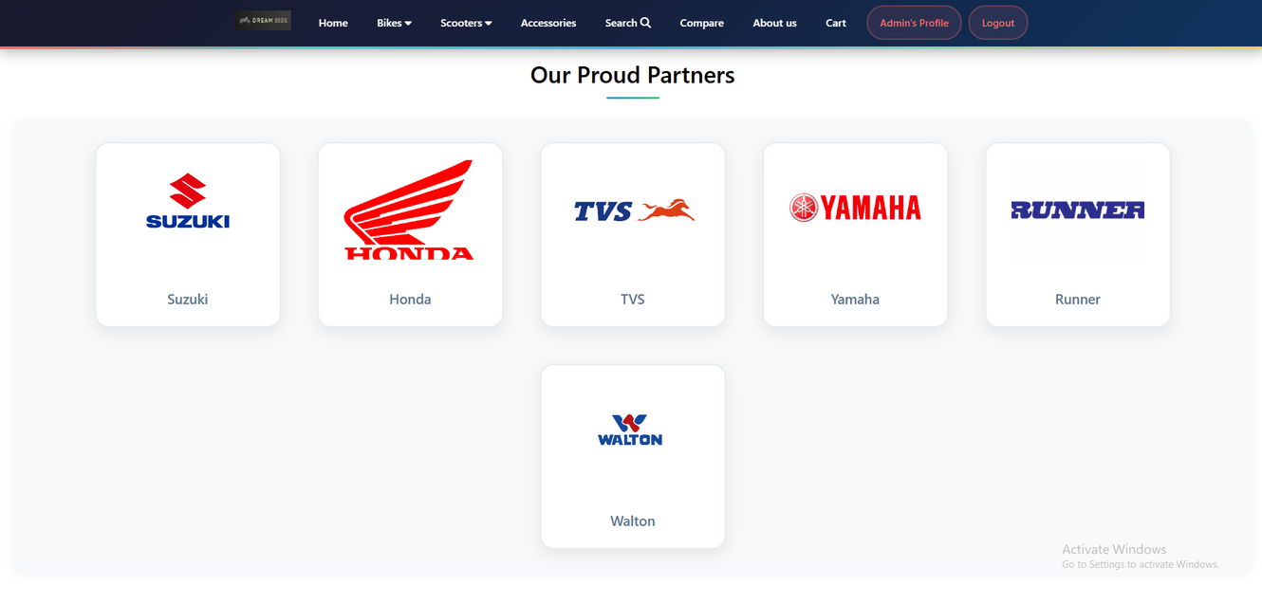
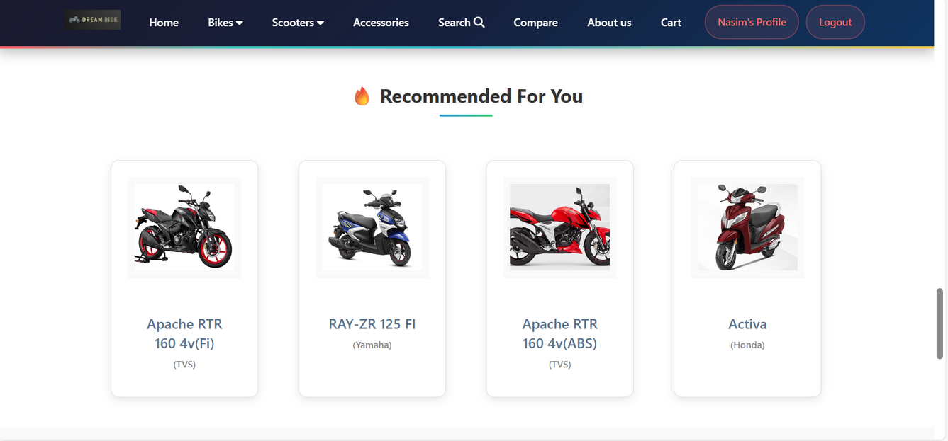
METHODOLOGY (FEATURES)
Architecture:
Client–server model, frontend (HTML, CSS, JS), backend (PHP, MySQL, Python).
Customer Features:
Signup/login, browse & filter products, compare bikes,
cart & recommendations, profile management.
Manager Features:
Dashboard for sales, add/update/remove products, customer info, generate invoices & reports.
Database Integration:
All products, sales, and customer data stored securely in MySQL.
Group :04
Md. Nasim Ahmed ID: 2232936042
Md. Abir Hasan ID: 2021833642
Md Murad Ul Momin ID: 2232360642

Slide 5
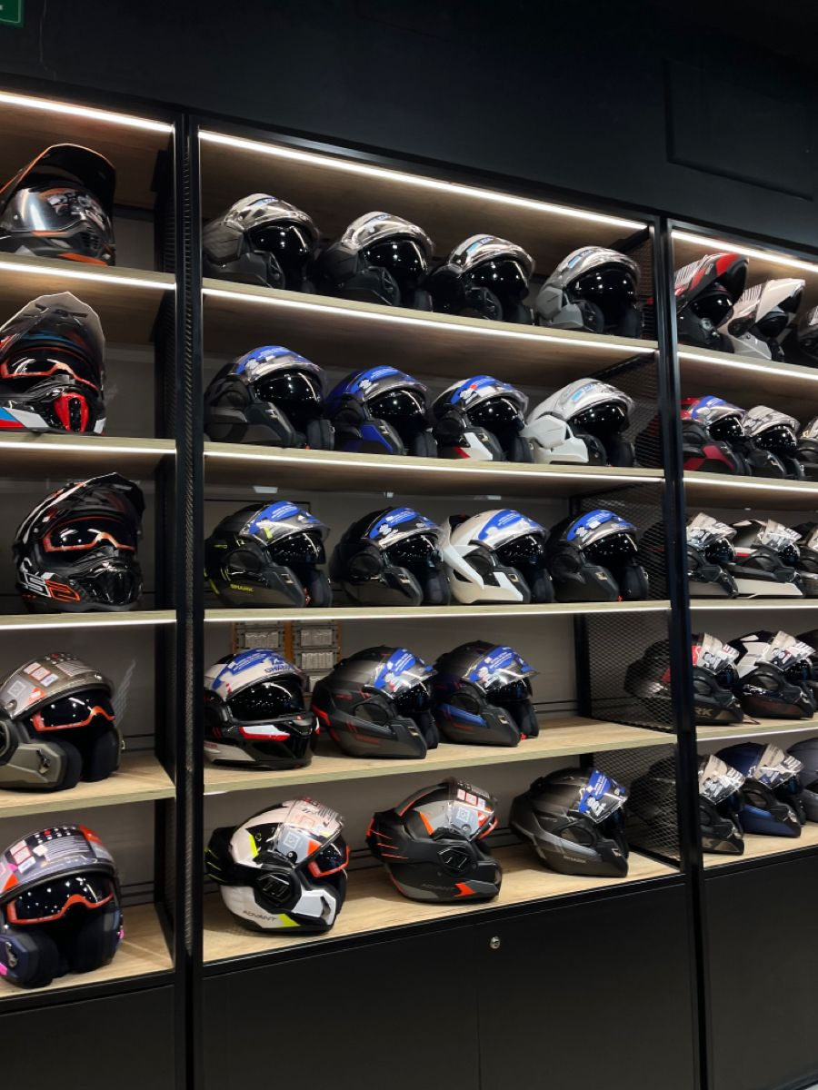
IMPACTS
Societal: Easier shopping, price transparency, booking test rides online.
Health & Safety: Promotes helmets & safety gear with bike purchases.
Legal: Secure customer data handling, digital invoices reduce disputes.
Environmental: Paperless invoices, less overstock, reduced unnecessary travel.
Group :04
Md. Nasim Ahmed ID: 2232936042
Md. Abir Hasan ID: 2021833642
Md Murad Ul Momin ID: 2232360642

Slide 6
COMPLEX ENGINEERING PROBLEMS (CEP)
Knowledge Depth | Conflicting Requirements | Stakeholder Involvement
Required expertise in PHP, JS, databases, and UI/UX principles. | Balancing rich features vs. performance & speed. | Several stakeholders are involved in the project, including store owners, customers, sales staff, and system administrators.
Group :04
Md. Nasim Ahmed ID: 2232936042
Md. Abir Hasan ID: 2021833642
Md Murad Ul Momin ID: 2232360642

Slide 7
COMPLEX ENGINEERING ACTIVITIES (CEA)
Resources | Interactions
Human collaboration, servers, databases, and development tools. | Regular coordination among team members, store owners, and potential users.
Group :04
Md. Nasim Ahmed ID: 2232936042
Md. Abir Hasan ID: 2021833642
Md Murad Ul Momin ID: 2232360642

Slide 8

FutURE IMPROVEMENT
Online payment integration.
Mobile app version.
Chatbot integration.
Forgot password.
Buy second-hand bikes.
Guess the bike price.
Contact with customers.
Group :04
Md. Nasim Ahmed ID: 2232936042
Md. Abir Hasan ID: 2021833642
Md Murad Ul Momin ID: 2232360642

Slide 9


CONCLUSION
Provides an all-in-one management solution for bike stores.
Improves efficiency, accuracy, and customer satisfaction.
Limitations: scalability, hardware dependence, maintenance, and security risks.
Group :04
Md. Nasim Ahmed ID: 2232936042
Md. Abir Hasan ID: 2021833642
Md Murad Ul Momin ID: 2232360642

Slide 10
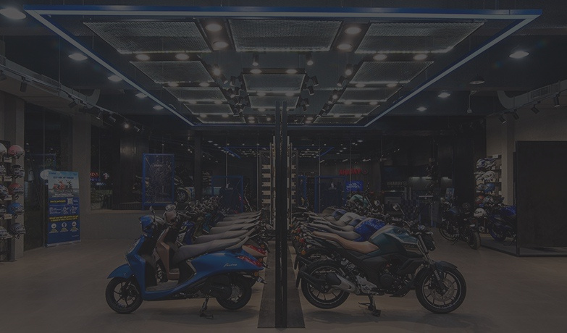
THANK YOU!
ANY QUESTIONS??

